Slide 1
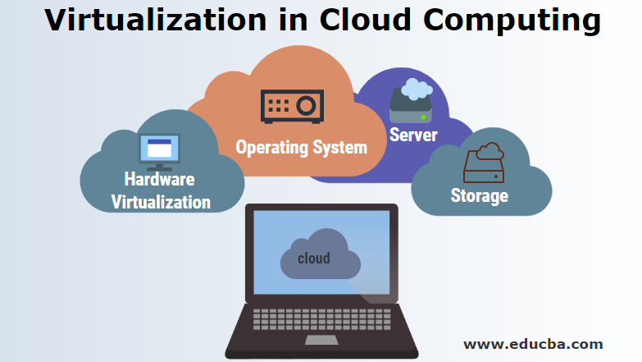

Slide 2
OUTLINE
Virtualization: definition, goals
The Virtualization Reference Model (guest, host, hypervisor)
Key advantages: security, managed execution (sharing, aggregation, emulation, isolation), portability, live migration, snapshots
Taxonomy: execution (process & system), storage, network virtualization
Machine reference model: ISA, ABI, API, privilege rings
Hypervisor types: Type 1 (bare metal) vs Type 2 (hosted) –
Hypervisor internal architecture: dispatcher, allocator, interpreter

Slide 3
VIRTUALIZATION
Definition: A layer of software (hypervisor or VMM) that abstracts physical hardware resources (CPU, memory, storage, network) and presents them as multiple isolated virtual instances.
Core goals:
Decoupling – software no longer tied to specific hardware.
Multiplexing – many guests share one physical host.
Isolation – faults/attacks do not cross VM boundaries.
For example, we can run Windows OS on top of a virtual machine, which itself is running on Linux OS.
Virtualization provides a great opportunity to build elastically scalable systems that can provision additional capability with minimum costs.

Slide 4
CHARACTERISTICS OF VIRTUALISED ENVIRONMENT
Virtualization is a broad concept that refers to the creation of a virtual version of something, whether hardware, a software environment, storage, or a network. In a virtualized environment there are three major components: guest, host, and virtualization layer.
The guest represents the system component that interacts with the virtualization layer rather than with the host, as would normally happen. The host represents the original environment where the guest is supposed to be managed.
The virtualization layer is responsible for recreating the same or a different environment where the guest will operate.

Slide 5
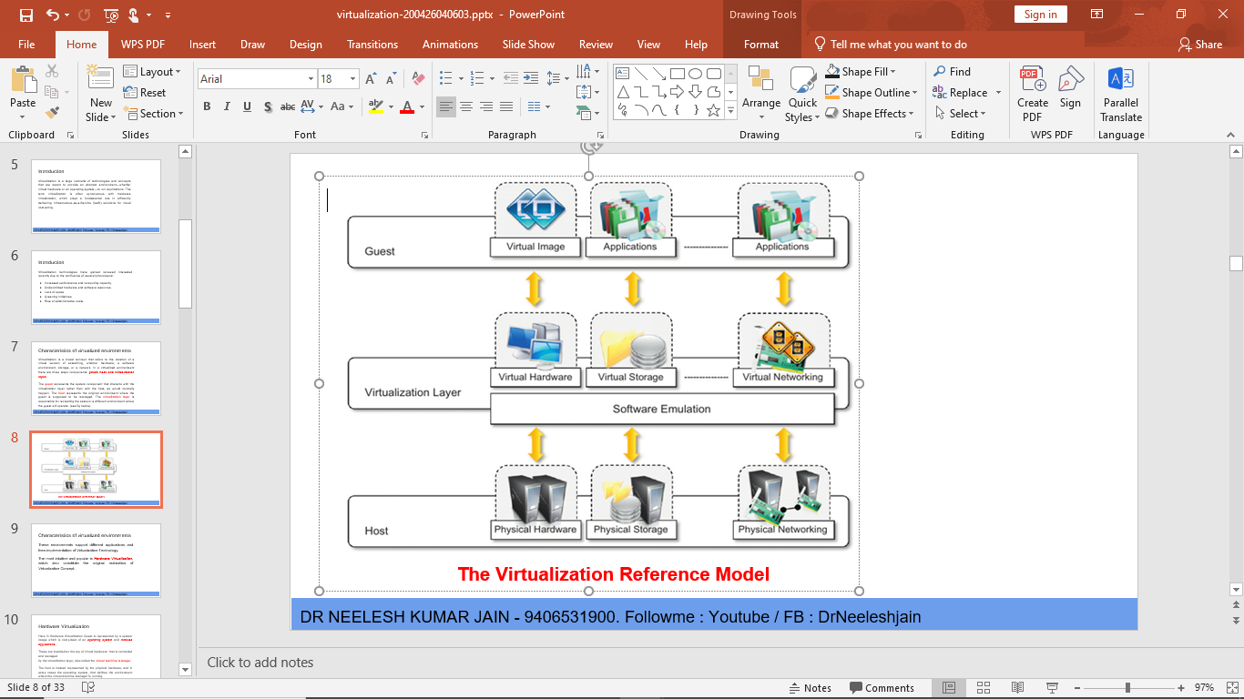


Slide 6
VIRTUALIZATION REFERENCE MODEL
Guest – virtual machine consisting of OS + applications. Believes it owns real hardware.
Host – physical hardware (CPU, RAM, disks, NICs) + possibly a host OS (in Type 2).
Hypervisor (VMM) – software/firmware that arbitrates all guest access to hardware.
Critical functions of hypervisor:
Traps privileged instructions from guest.
Emulates sensitive instructions.
Manages physical memory mapping (Shadow Page Tables or NPT/EPT).
Schedules guest CPU time.
Example: When a guest VM tries to disable interrupts (CLI instruction), the hypervisor intercepts it and emulates the effect without actually changing host CPU state.

Slide 7
ADVANTAGES OF VIRTUALIZATION
Enhanced Security
Hypervisor runs at higher privilege level (Ring -1) than guest OS (Ring 0).
Each VM is a sandbox – malicious code inside VM cannot break out to hypervisor or other VMs without a hypervisor escape (rare, patched quickly).
Hardware security features encrypt VM memory even from hypervisor.
Example: A cloud provider runs customer VMs. Even if one customer’s VM is rooted, the attacker cannot access another customer’s VM or the hypervisor’s management interface.

Slide 8
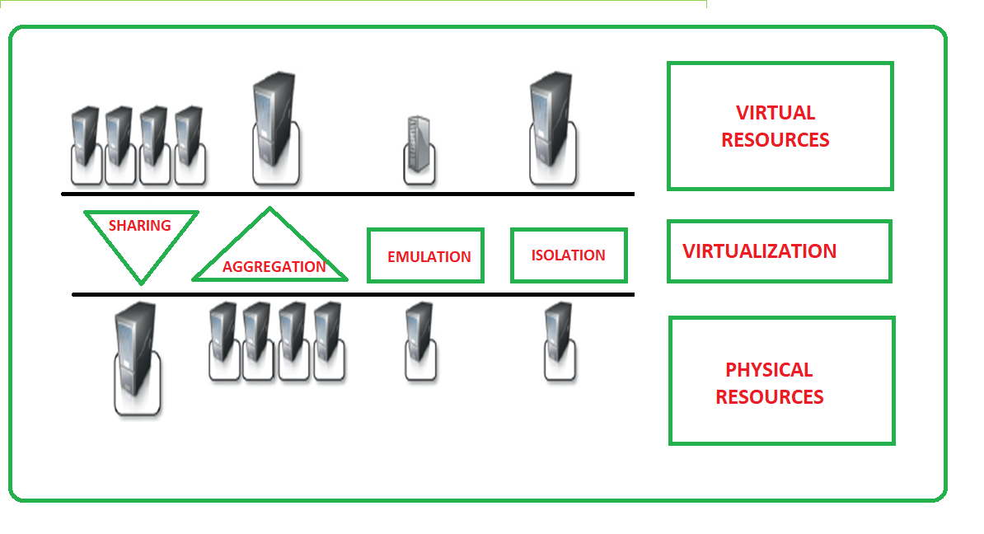
ADVANTAGES OF VIRTUALIZATION

Slide 9
ADVANTAGES OF VIRTUALIZATION
Managed Execution: Sharing & Aggregation
Sharing (multi-tenancy): One physical host runs dozens of VMs. Hypervisor shares CPU cores via time-slicing, RAM via overcommitment, and I/O via queues.
Aggregation (clustering): Multiple physical hosts appear as one logical resource pool using distributed resource scheduler (DRS) – e.g., VMware vSphere, OpenStack.
Example: A Hadoop cluster of 20 physical machines is aggregated into a single virtual data lake; users submit jobs without knowing which physical node runs them.

Slide 10
ADVANTAGES OF VIRTUALIZATION
Managed Execution: Emulation & Isolation
Emulation: Simulates hardware that does not exist physically (e.g., ARM on x86, old PCI devices)..
Isolation: Faults in one VM (kernel panic, infinite loop) cannot crash other VMs or host. Hypervisor enforces memory protection and CPU limits.
Example: A QA team tests a buggy Windows driver inside a VM. The driver causes a BSOD inside the VM, but the hypervisor continues running unaffected.

Slide 11
ADVANTAGES OF VIRTUALIZATION
Advantage: Portability & Live Migration
Portability: VM encapsulated as files (disk image, config, NVRAM). Can be copied, moved, or backed up like any file.
Live migration (vMotion, KVM live migration): Move a running VM from one physical host to another with zero downtime. Memory pages are copied iteratively; CPU state transferred at the end.
Example: A physical server needs firmware update. Administrators live‑migrate all 30 VMs to another host, then update the empty server. No user interruption

Slide 12
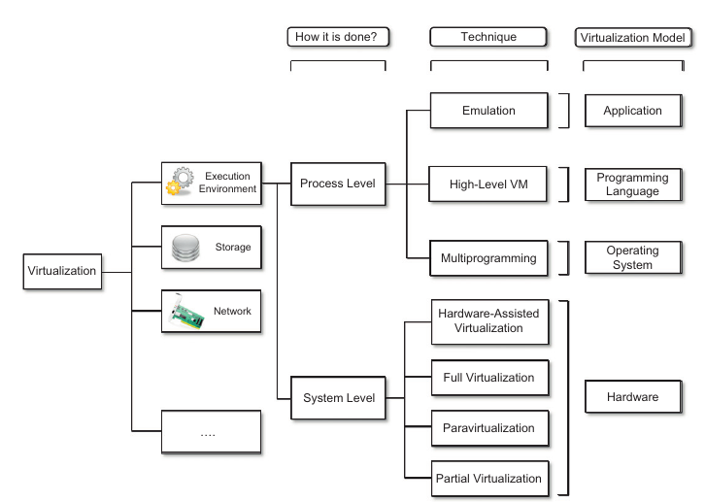
TAXONOMY OF VIRTUALIZATION TECHNIQUES

Slide 13
TAXONOMY OF VIRTUALIZATION TECHNIQUES
Virtualization is mainly used to emulate
Execution Environments : To provide support for the execution of the programs for eg. OS, Application.
  Process Level : Implemented on the top of an existing OS which has full control of the hardware
  System Level : Implemented directly on Hardware and do not require support from existing OS.
Storage : Storage virtualization is a system administration practice that allows decoupling the physical orga nization of the hardware from its logical representation.
Networks : Network virtualization combines hardware appliances and specific software for the creation and management of a virtual network.

Slide 14
VIRTUALIZATION A MACHINE REFERENCE MODEL (PROCESS LEVEL)
When an execution environment is virtualized at unlike levels of the stack of computation then it requires a reference model which defines the interfaces within the level of abstractions, and this level of abstraction hides the details of implementations.
This projects an idea that, virtualization techniques can substitute any one layer and can intercept the calls which are directed to it. That’s why a clear separation within the layers can simplify their implementations, which only need an emulation of the interfaces and a proper response with the underlying layer

Slide 15
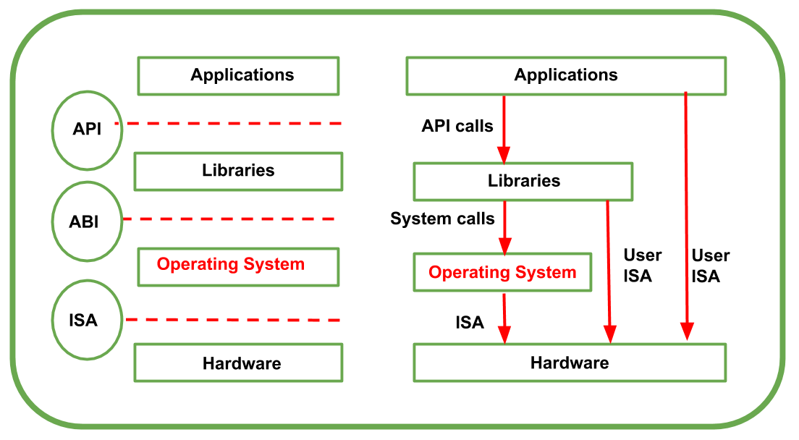
VIRTUALIZATION A MACHINE REFERENCE MODEL
At the base layer, the model for the hardware is declared or manifested on terms of an architecture i.e. Instruction Set Architecture (ISA).

Slide 16
VIRTUALIZATION - A MACHINE REFERENCE MODEL
Instruction Set Architecture (ISA) defines the instruction set for the processor, registers, memory, and interrupt management.
It is an interface between software and hardware and It is mandatory for the operating system (OS) developer (system ISA) developers of applications who directly manages core hardware (user ISA).
The operating system layer is separated by the application binary interface (ABI) from the application and libraries, which are managed by operating system.

Slide 17
VIRTUALIZATION - A MACHINE REFERENCE MODEL
Application Binary Interface (ABI) covers facts such as low-level data types and call conventions and it also defines a format for many programs. Mainly, system calls are defined at this level. Moreover, this type of interface enables portability of various applications and libraries across OS which employ the same ABI.
Application programming interface (API) is represented by the highest level of abstraction. This API interfaces applications to libraries and/or the core OS. For an action is to be performed in the application level API, ABI are the two which are responsible to make it done. Mainly, CPU runs on two privilege levels:
User Mode: In this mode, memory access is restricted up to some limit whereas access to peripherals is denied.
Kernel Mode: In this mode, CPU has instructions which manage memory and how to be accessed and it also has instructions which enable access of the peripherals like disks and network cards. From one running program to another running program, CPU switches automatically

Slide 18
Hardware-(system-level) virtualization
Hardware-level virtualization is a virtualization technique that provides an abstract execution environment in terms of computer hardware on top of which a guest operating system can be run.
In this model, the guest is represented by the operating system, the host by the physical computer hardware, the virtual machine by its emulation, and the virtual machine manager by the hypervisor.
The hypervisor is generally a program or a combination of software and hardware that allows the abstraction of the underlying physical hardware. Hardware-level virtualization is also called system virtualization

Slide 19
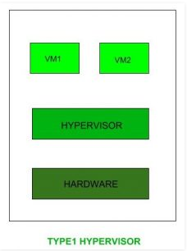
TYPES OF HYPERVISORS
TYPE-1 Hypervisor:
Hypervisor runs directly on underlying host system.It is also known as “Native Hypervisor” or “Bare metal hypervisor”.It dose not require any base server operating system.
It has direct access to hardware resources.Examples of Type 1 hypervisors include VMware ESXi, Citrix XenServer and Microsoft Hyper-V hypervisor.

Slide 20
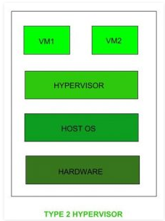
TYPES OF HYPERVISORS
TYPE-2 Hypervisor:
A Host operating system runs on undrlying host system.It is also known as ‘Hosted Hypervisor”.
Basically a software installed on an operating system.Hypervisor asks operating system to make hardware calls.
Example of Type 2 hypervisor include VMware Player or Parallels Desktop. Hosted hypervisors are often found on endpoints like PCs.

Slide 21
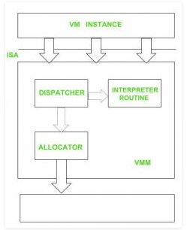
HYPERVISOR REFERENCE MODEL
DISPATCHER:
The dispatcher behaves like the entry point of the monitor and reroutes the instructions of the virtual machine instance to one of the other two modules.
ALLOCATOR:
The allocator is responsible for deciding the system resources to be provided to the virtual machine instance.It means whenever virtual machine tries to execute an instruction that results in changing the machine resources associated with the virtual machine, the allocator is invoked by the dispatcher.
INTERPRETER:
The interpreter module consists of interpreter routines.These are executed, whenever virtual machine executes a priviliged instruction.

Slide 22
Thanks so much.

